Slide 1
Status of CEPC xxxxxxxx Readout Electronics

Slide 2
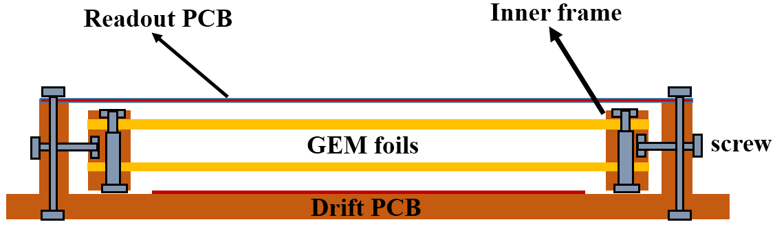
SDHCAL based on GEM
GEM with self-stretching techniques
Advantages：
1. Easy assembling
2. Uniform gas flow
3. Detachable
4. No dead area inside the active area
Detector and readout plane with 1cmx1cm size
Notes:
Another job under researching is the SDHCAL pre-search based on GEM detector. A self-stretching techniques is used in assembling the GEM detector. This figure shows the structure of the detector. With this method, the assembling process is easy and fast and there is no dead area inside the active area. This figure shows the assembling process of the detector and this figure shows the readout plane. The readout pad is sized 1square centimeter.

Slide 3
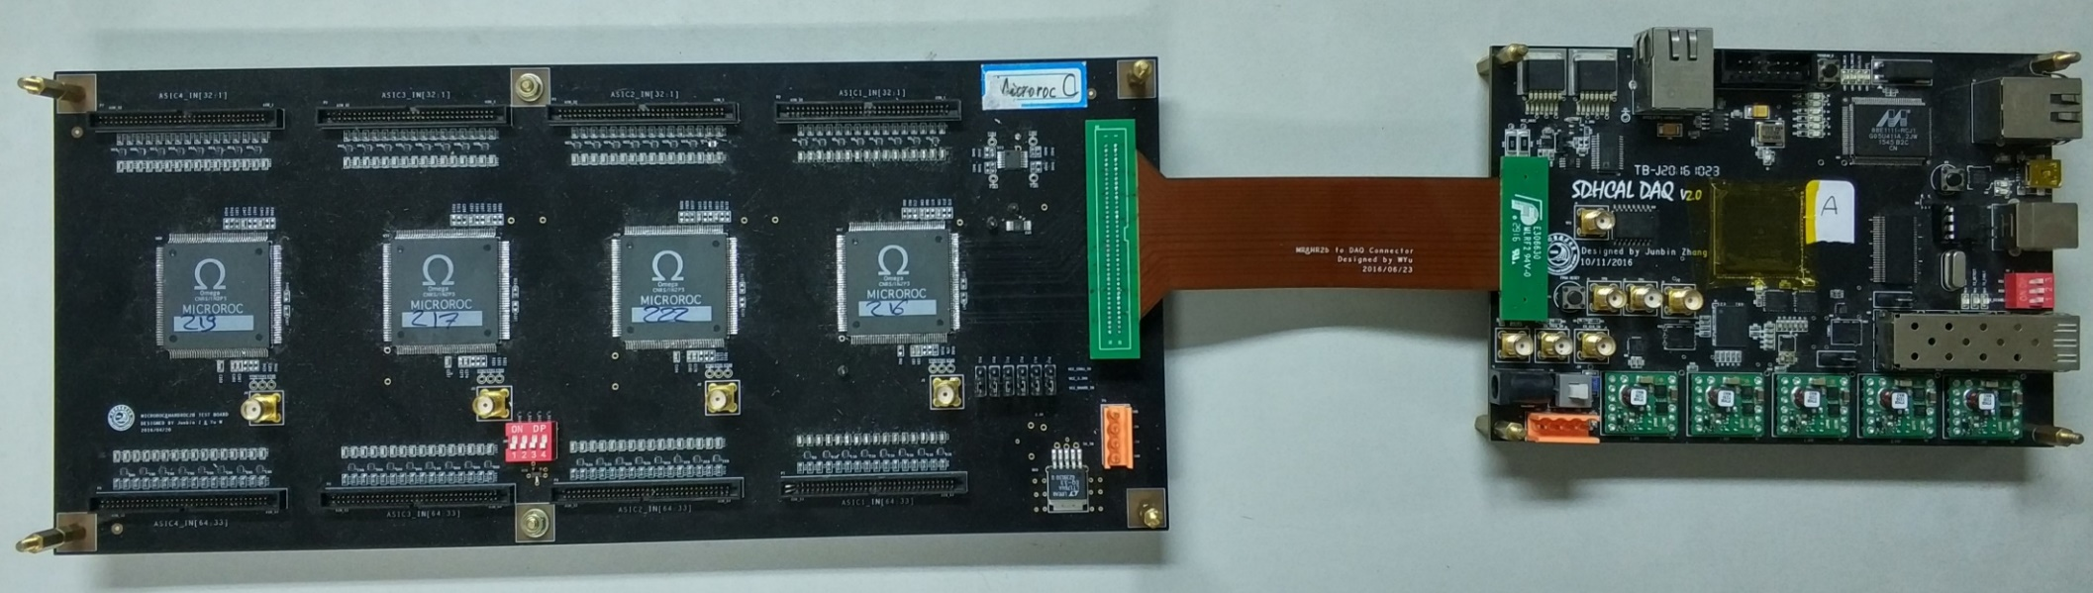
Readout Electronics Design
FEB with MICROROC*
Single board with 256 channels
Connected via flexible plate
DIF
Multiple readout interfaces such as DTCC, SFP, Ethernet and USB
Notes:
Here shows the readout electronics design of the first stage. The readout electronics contains two parts: front-end electronics board and detector interface board. The front-end electronics board is mounted with 4 MICROROC ASICs which was designed by OMEGA groups. A single FEB can readout 256 channels and the detector signal is connected via flexible plate. The DIF board control the ASIC and read back the hit information. It has multiple readout interfaces such as DTCC, SFP, Ethernet and USB

Slide 4
Cosmic-Ray Test
Test the efficiency and multiplicity using cosmic-ray
Use two PMT for coincidence detection
Notes:
Thanks to the help of OMEGA group, the ASIC works well and the performance is similar as previous work. And then we test the performance of the detector combined with the readout electronics. Here shows the test scheme and the test environment. These two PMT is used for coincident detection. We mainly scan the gain of the detector and the threshold to test the detection efficiency and multiplicity

Slide 5
Cosmic-Ray Test
Scan the gain of detector to obtain the efficiency and multiplicity
Scan the threshold under thes
Detection efficiency and multiplicity vary with voltage
Detection efficiency and multiplicity vary with threshold
Notes:
Cosmic ray test results indicated detection efficiency of the double layer GEM detector to MIPs can reach 95% with 5fc threshold, and multiplicity was between 1.1 and 1.2 while detection efficiency was 95%, as shown in the left figure. Detection efficiency and multiplicity varied with thresholds has been measured. The right figure presents the test results, it can be seen that the higher the threshold, the lower the efficiency and also the multiplicity. It should be noted that the multiplicity would tend to a value at last.

Slide 6
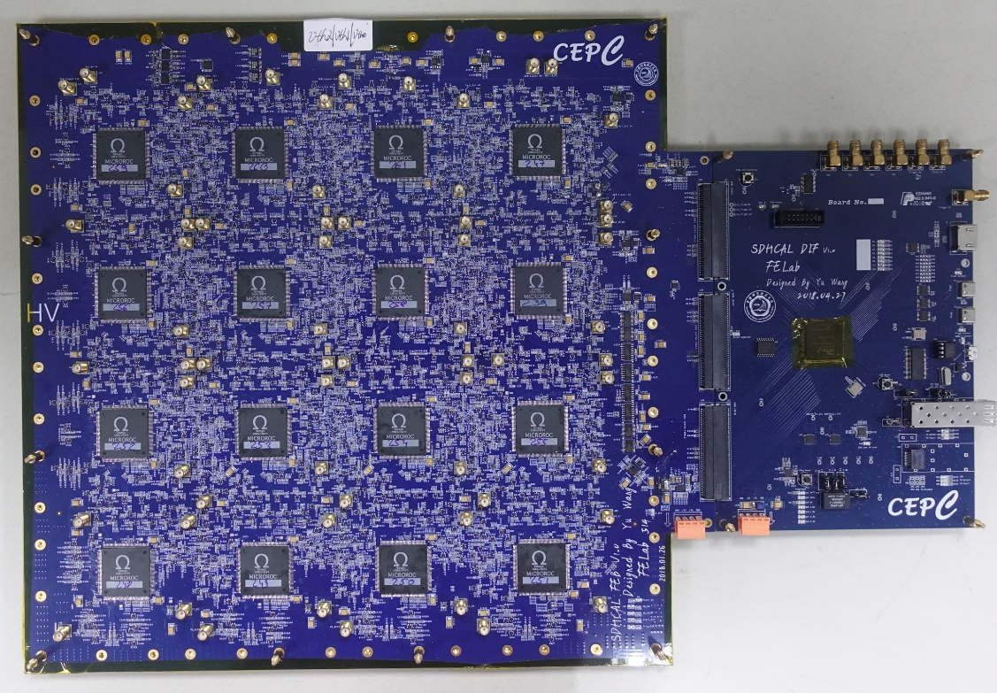
Next Step
A readout plane with embedded front-end electronics is designed
Blind buried via technique is used to ensure the signal integrity and gas tightness
Notes:
In order to reduce the "dead area" caused by electronics, a readout plane with embedded front-end electronics is designed. Blind buried via technique is used to ensure the signal integrity and gas tightness. This picture shows the PCB of the new FEB and DIF and the test procedure is undergoing

Slide 7
Back Up

Slide 8
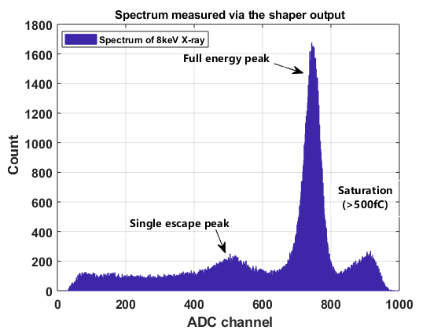
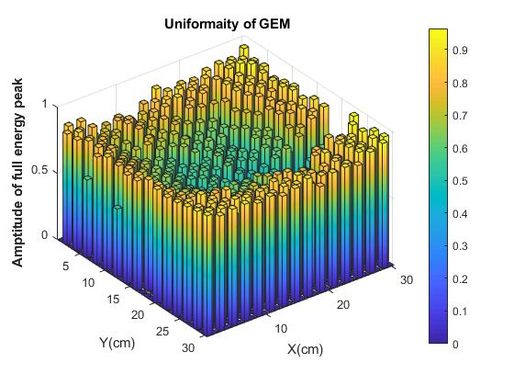
Laboratory Test
An external ADC is applied to measure the X-Ray energy spectrum
The detector gain uniform is obtained by the spectrum

